Slide 1
i.MX platform Linux Tools Usage
Leo Liu
7/14/2014

Slide 2
Content
Server introduction
Platform introduction
Source code directory introduction
How to set up platform environment
How to run test cases

Slide 3
Server introduction
Linux Server Statistics
Server Name | IP | OS | Description
shlx8(backup server) | 10.192.225.218 | FC4 2.6.11 | Backup Server for shlx9 + tftp server
* shlx9(file server) | 10.192.225.219 | 2.4.21 | File Storage Server+Backup Server
* server6(L3.10 test server) | 10.192.244.6 | Ubuntu | L3.10 armhf, TFTP, rootfs, VTE test binary server
* lbgtest1(Linux Workstation Intern) | 10.192.244.161 | Ubuntu 13.04 | For intern burn image and test use in SH
shlx12(L3.0.35 test binary server) | 10.192.225.222 | Ubuntu 2.6.24 | Development Server(open root permission) + vte nfs server
*ReleaseCandidate | 10.192.224.48 |  | Linux Release Candidate

Slide 4
Server introduction
Server in SuZhou (10.193.102.100)
/home/tftpboot
Linux kernel image & dtb binary for i.MX platform
you can get them by setting uboot environment:
bootp ${loadaddr} ${tftpaddr}:${kernel};bootp ${fdt_addr} ${tftpaddr}:${fdt_file}
tftpaddr= 10.193.102.100
/rootfs
Root file system for i.MX platform
you can boot board from NFS rootfs:
root=/dev/nfs ip=dhcp nfsroot=${serverip}:${nfsroot},v3,tcp
serverip=10.193.102.100
nfsroot= /rootfs/imx**_rootfs_r
st_rootfs (reboot test) imx**_rootfs_r_fb/wld/dfb( GPU special bankend)

Slide 5
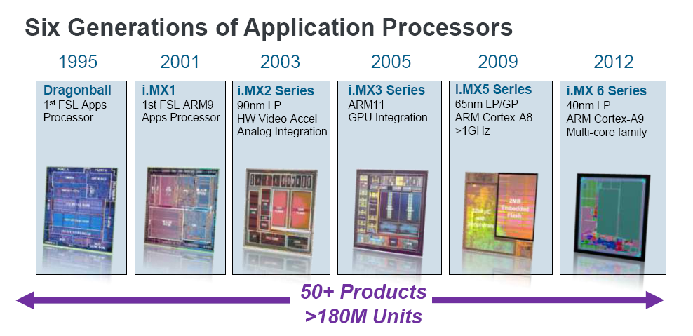
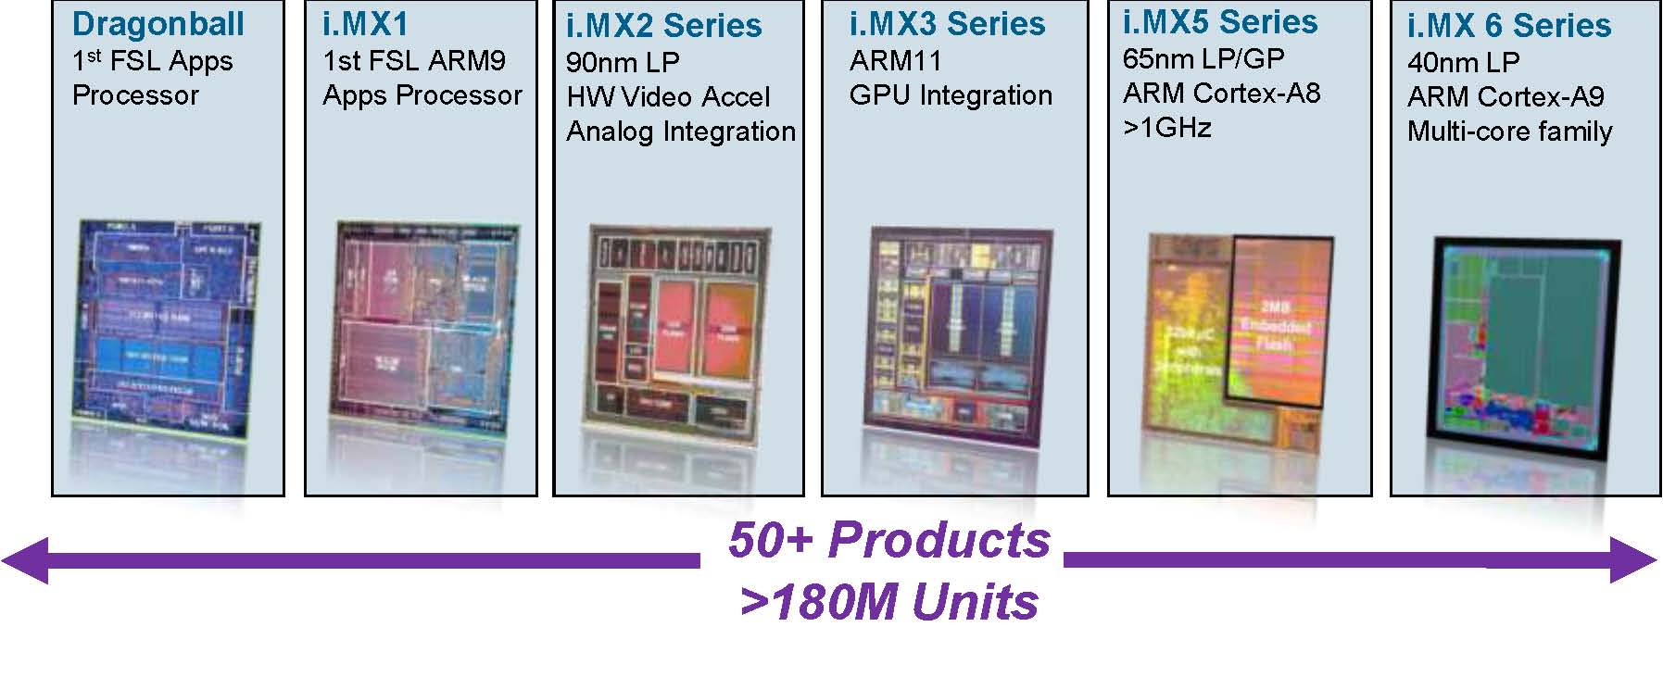
Platform introduction

Slide 6
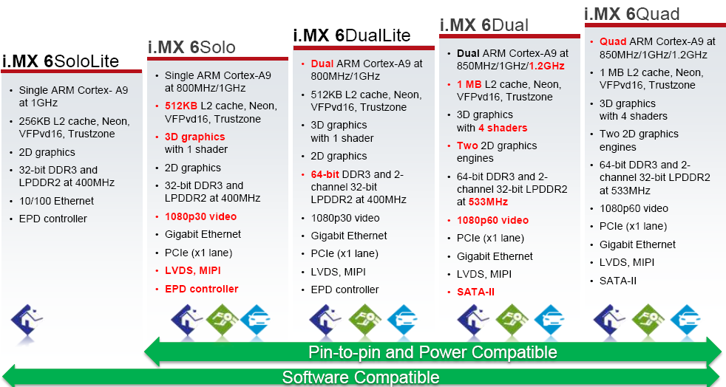
Platform introduction
New platform i.MX6SX (A9+M4)

Slide 7
Platform introduction
i.MX6SL----mx60
EVK
i.MX6DL----mx61
Sabre-SD, Sabre-auto, ARM2
i.MX6SX----mx62
Sabre-SD, ARM2(17x17, 19x19), Sabre-auto(in future)
i.MX6Q ----mx63
Sabre-SD, Sabre-auto

Slide 8
Source code directory introduction
Linux kernel source code:
1.Clone kernel source code to local
$git clone git://sw-git.freescale.net/linux-2.6-imx.git
$git checkout -b imx_3.10.31_1.1.0_beta -t origin/imx_3.10.31_1.1.0_beta (if this branch is not cloned to local yet)
2. Check the current branch is the right branch:
$git branch
$git checkout imx_3.10.17_1.0.0_beta (if this branch is cloned to local already, switch to a local branch.)
$git pull (Sync to latest on remote branch)

Slide 9
Source code directory introduction
3.Modify module config according to test case
make imx_v7_defconfig
make menuconfig
make uImage LOADADDR=0x80008000
mx60/62=0x80008000, others =0x10008000
rename the zImage,and copy to tftpboot or burn into SD card.
mv zImage zImage_****
cp zImage_**** /home/tftpboot/
make modules
make modules_install INSTALL_MOD_PATH=/rootfs/imx60_rootfs_r
NOTE: When you boot up, please make sure your kernel version and rootfs lib folders version are same with you build.
uname –a
ls /lib/modules/

Slide 10
Source code directory introduction
uboot source code:
1. clone uboot source code to local
git clone git://sw-git.freescale.net/uboot-imx.git
2. modify uboot config file according to test case
uboot-imx$ vim include/configs/mx***.h
3. rebuild uboot, such as mx6sl-evk
uboot-imx$ make mx6slevk_config
uboot-imx$ make
4. rename the uboot, burn into SD card.

Slide 11
Source code directory introduction
VTE source code(Shell Script and APP)
1.Clone VTE to local
git clone git://10.192.225.222/vte
2.modify the code want to modify.
$ git status
$ git add /testcases/bin/dfb_gc320.sh
if you use $git add -a ,it save all the modification include some not important), you can add the specific modification you want to push using the above command.
$ git commit -s
Please leave a blank line before Signed-off-by in commit message
Please add module name before commit message: GPU-make soft link needed libs to dfb automatically
Push to L3.10 VTE:
$ git push origin HEAD:refs/for/master

Slide 12
Source code directory introduction
3.Code review (http://10.192.225.222:8080)
modify the codes.
git add xxx.sh
git commit --am
modify the commit message, add the change-ID to the behind of sign off. just like:
Signed-off-by: b46701 <b46701@freescale.com>
Change-Id: I78c005fac4ed212e32eacf9c0fcb8847acd7fc33
it will upload patch set 2 instead of creating a new patch review.
then git push: $ git push origin HEAD:refs/for/imx_3.0.35

Slide 13
How to set up platform environment
Environment prepare
on your Linux server, mount our release server
#sudo mount -o username=guest -t cifs //10.192.224.48/LinuxReleaseCandidate /mnt/release_candidate/
on your own Linux server, mount our rootfs server
#sudo mount -t nfs -o nolock 10.10.193.102.100:/rootfs/ /mnt/rfs
Insert your SD card to SD card reader on your server.
Check your SD card partition.
#cat /proc/partitions
umount the sd card:
#sudo umount /dev/sdx*

Slide 14
How to set up platform environment
Prepare SD card for boot up
NFS rootfs card prepare
Burn uboot.imx to SD card.
#cd /mnt/release_candidate/L3.10.31_1.1.0_beta_RC1/Image/fsl-image-x11/imx_uboot(use right release)
#sudo dd if=u-boot-imx6dlsabresd_sd.imx(use right uboot.imx file for your platform) of=/dev/sdx bs=1024 seek=1
Burn uboot config to SD card.
#cd /mnt/rfs/imx63_rootfs_r/root
# sudo dd if=u-boot-IMX6Q-Sabre-SD-conf-dtb-config.bin(use right config file for your platform) of=/dev/sdx bs=1024 seek=512
SD rootfs card prepare
#cd /mnt/release_candidate/L3.10.31_1.1.0_beta_RC1/Image/fsl-image-x11/imx6qdlsolo/
$sudo dd if=fsl-image-x11-imx6qdlsolo-20131221002055.rootfs.sdcard of=/dev/sdx (use right sdcard file for your platform) bs=4M
tar -jxf fsl-image-x11-imx6qdlsolo.tar.bz2 -C /mnt/msc
now the SD card can boot up on MX6DQ? SD board successfully.

Slide 15
How to run test cases
1.Insert the SD card(with uboot burned at least) to your board.
Note:Refer to case TGE-LV-BoardSetting-0001 for detail boot settings.
2.Connect your board to your PC with USB-UART or USB-Serial cabel.
Note: you need to install the related driver for these cables.
3.Plug in the Ethernet cable to board
4.Open the serial port on your PC with putty.exe or other program you like.
5.Power on the board and you can see U-boot info printed on console port.
6.Hit any key to enter uboot setting.

Slide 16
1.Configure uboot manually
http://10.192.225.222/gitphp/index.php?p=skywalker&a=tree
print
setenv xxx 'xxx'
save
2.uboot config by dd command
config file, such as "u-boot-IMX6Q-Sabre-SD-config.bin".
$dd if=u-boot-IMX6Q-Sabre-SD-config.bin of=/dev/mmcblk1 bs=1k seek=512

Slide 17
How to run test cases
Modify uboot config
Some key value:
bootargs console=ttymxc0,115200 no_console_suspend release
kernel zImage_mx60
fdt_file
dtb_mx60evk is release test
imx6sl-evk.dtb is daily build
tftpaddr 10.193.102.100
serverip 10.193.102.100
nfsroot /rootfs/imx60_rootfs_r

Slide 18
How to run test cases
execute manual test case:
For kernel version after 3.10
First mount our vte server(if use nfs rootfs, not need to do it)
#mount -t nfs -o nolock 10.192.244.6:/rootfs/wb /mnt/nfs
Change to corresponding directory.
#cd /mnt/nfs/vte_mx61_hf for MX6DL? platform
#cd /mnt/nfs/vte_mx63_hf for MX6DQ? platform
Source VTE environment
#. ./manual_test
now you can run manual test command.

Slide 19
How to run test cases
Run auto test.
On linux server, cd vte directory, chek cmd file.
Cmd file is generated by XiaoTian.
cd /mnt/rfs/wb/vte_IMX6DL-Sabre-SD/runtest
(If /mnt/rfs has been mounted on 244.6 rootfs)
Add command file to uboot config.
add‘daily_test=imx61_SMD_auto’ to bootargs_base
imx61_SMD_auto is cmd file generated by XT, you can also use yourself one.
Check test result, upload into XiaoTian: PASS/FAIL/NA/NS
http://10.192.244.6/daily_test/

